Slide 1
Programming Applications
Spring 2021-2022
Assist. Prof. Dr. Pelin GÖRGEL (pelin.gorgel@iuc.edu.tr)
23.02.2022

Slide 2
Grading
Midterm Exam : %25
Project : %25
Final Exam : %50
Project product should be a software developed with HTML, JSF and a relevant database.

Slide 3
Course Resources
Textbook: How to Program JAVA Deitel & Deitel
Lecture Slides
Attendance
Attendance at the lectures will not be taken.

Slide 4
What is HTML?
HTML is a language for describing web pages.
HTML stands for Hyper Text Markup Language
HTML is a markup language
A markup language is a set of markup tags
The tags describe document content
HTML documents contain HTML tags and plain text
HTML documents are also called web pages
A "markup language" is a computer language that describes how a page should be formatted.
If you want to change fonts, add colors, create headlines and embed graphics in your page, HTML is the language you use to do it.

Slide 5

A Web Page

Slide 6
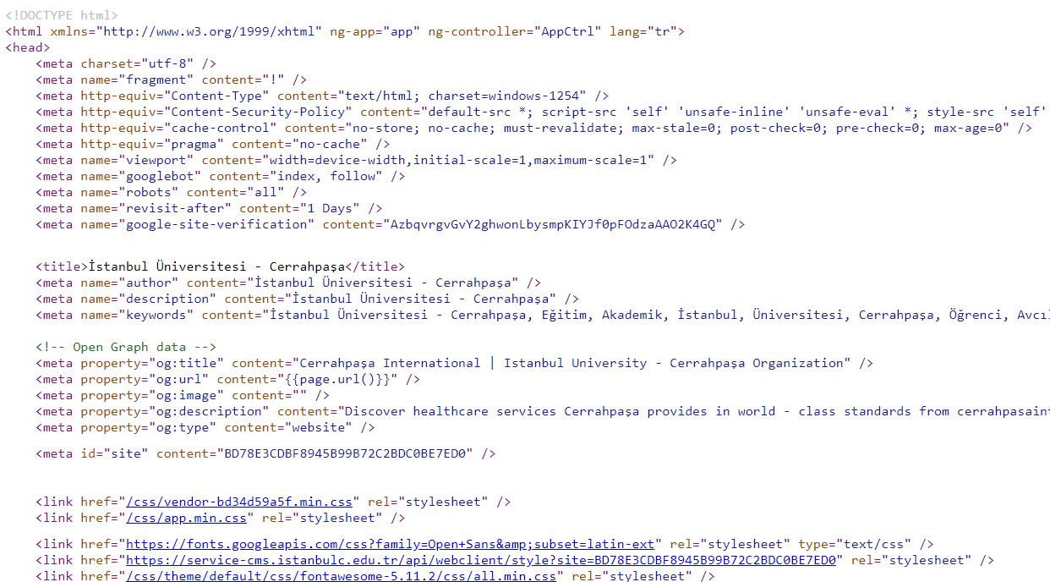
Sample HTML Code

Slide 7
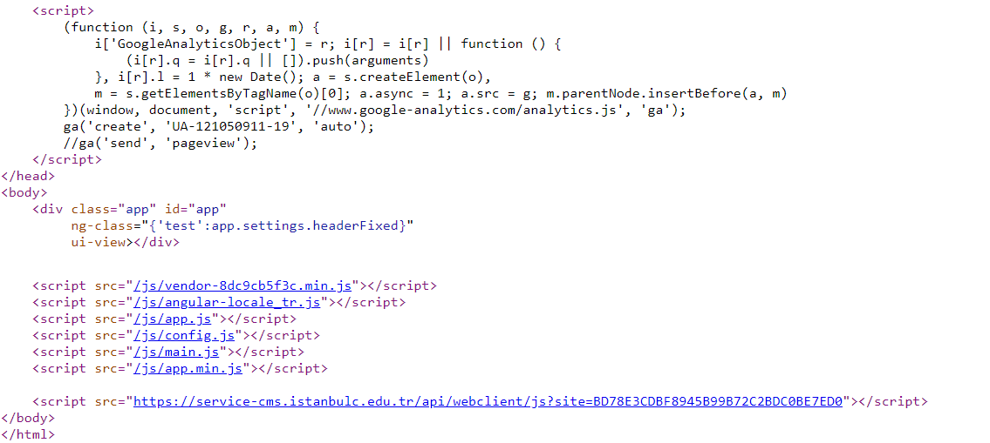
Sample HTML Code

Slide 8
A Simple HTML Code
<!DOCTYPE html>
<html>
<body>
<h1>My First Heading</h1>
<p>My first paragraph.</p>
</body>
</html>
The DOCTYPE declaration defines the document type
The text between <html> and </html> describes the web page
The text between <body> and </body> is the visible page content
The text between <h1> and </h1> is displayed as a heading
The text between <p> and </p> is displayed as a paragraph

Slide 9
HTML Tags
HTML markup tags are usually called HTML tags
Start and end tags are also called opening tags and closing tags
HTML tags are keywords (tag names) surrounded by angle brackets like <html>
The first tag in a pair is the start tag, the second tag is the end tag
The end tag is written like the start tag, with a forward slash before the tag name
HTML tags normally come in pairs like <b> and </b>
<tagname>content</tagname>

Slide 10
HTML Elements
"HTML tags" and "HTML elements" are often used to describe the same thing.
The tags are simple instructions that tell the Web browser how the page should look when it is displayed.
But strictly speaking, an HTML element is everything between the start tag and the end tag.
<html> The whole content comes here </html>

Slide 11
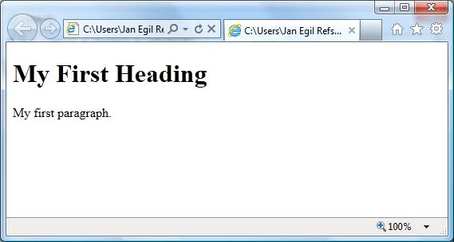
A Web Page

Slide 12
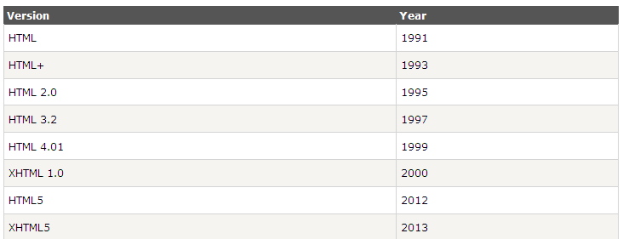
HTML Versions

Slide 13
The <!DOCTYPE> Declaration
The <!DOCTYPE> declaration helps the browser to display a web page correctly.
There are many different documents on the web, and a browser can only display an HTML page 100% correctly if it knows the HTML type and version used.

Slide 14
Common <!DOCTYPE> Declarations
HTML5
<!DOCTYPE html>
HTML 4.01
<!DOCTYPE HTML PUBLIC "-//W3C//DTD HTML 4.01 Transitional//EN"
"http://www.w3.org/TR/html4/loose.dtd">
XHTML 1.0
<!DOCTYPE html PUBLIC "-//W3C//DTD XHTML 1.0 Transitional//EN"
"http://www.w3.org/TR/xhtml1/DTD/xhtml1-transitional.dtd">

Slide 15
HTML Headings
HTML headings are defined with the <h1> to <h6> tags.
Example
<h1>This is a heading</h1>
<h2>This is a heading</h2>
<h3>This is a heading</h3>
Note:Use HTML headings for headings only. Don't use headings to make text BIG or bold.
Search engines use your headings to index the structure and content of your web pages.

Slide 16
HTML Paragraphs
HTML paragraphs are defined with the <p> tag.
Example
<p>This is a paragraph.</p>
<p>This is another paragraph.</p>

Slide 17
Adding Background Color
Change the background color of your page by adding bgcolor="color" within the tag.
Example:
<body bgcolor="yellow">
Again, as was described in the section on changing font color, you can use most standard colors, or use a Hexadecimal Color Code.

Slide 18
HTML Unordered Lists
An unordered list starts with the <ul> tag. Each list item starts with the <li> tag.
The list items are marked with bullets (typically small black circles).
<ul>
<li>Coffee</li>
<li>Milk</li>
</ul>
How the HTML code above looks in a browser:
Milk
Coffee

Slide 19
HTML Ordered Lists
An ordered list starts with the <ol> tag. Each list item starts with the <li> tag.
The list items are marked with numbers.
<ol>
<li>Coffee</li>
<li>Milk</li>
</ol>
How the HTML code above looks in a browser:
Coffee
Milk

Slide 20
HTML Ordered Lists
<ol type="A"> orders the list by capital letters: (A, B, C...)
<ol type="a"> orders the list by small letters: (a, b, c...)
<ol type="I"> orders the list by Roman numerals: (I, II, III...)
<ol type="i"> orders the list by small Roman numerals: (i, ii, iii...)
If you would like to start your ordered list with a specified value, such as "6," use the following "start" and "value" tags:
<ol start=5> <li value=6>

Slide 21
Some Additional HTML Elements
HTML elements with no content are called empty elements.
<br> is used to position at the beginning of the next line.
The <hr>tag creates a horizontal line in an HTML page.
<!-- This is a comment-->
<sub> <sup> <i>
<b>

Slide 22
HTML Layouts
Web page layout is very important to make your website look good.
Most websites have put their content in multiple columns (formatted like a magazine or newspaper).
Multiple columns are created by using <div> or <table> elements. CSS are used to position elements, or to create backgrounds or colorful look for the pages.
Even though it is possible to create advanced layouts with HTML tables, tables were designed for presenting tabular data - NOT as a layout tool!

Slide 23
HTML Links and HTML Images
HTML links are defined with the <a> tag. The target attribute is to open the link in a new tab
HTML images are defined with the <img> tag.
<a href="http://www.istanbul.edu.tr" target="_blank" rel="noopener noreferrer">This is a link </a>
<img src=“istanbul.jpg" width="104" height="142">

Slide 24

HTML Tables
<table border="1">
<tr>
<td>row 1, cell 1</td>
<td>row 1, cell 2</td>
</tr>
<tr>
<td>row 2, cell 1</td>
<td>row 2, cell 2</td>
</tr>
</table>

Slide 25
Table Size
The width and height of rows and columns in a table will expand automatically to fit the length of data and/or the space of the browser window. To specify a width and height, include either pixels or percentage values within the starting "table" tag:
Example: <table width=300 height=400>
Width and height can also be specified for an individual data cell, as opposed to the table as a whole. To do this, add width="value" to the <tr> or <td> tag in question.
Again, it's a good idea to simply experiment with pixel and percentage values to find out what they look like in a browser.

Slide 26
Table Size
Cellpadding
The "cellpadding" tag specifies (in pixels) the amount of space between the edges of each cell and the data inside each cell. Use it within the starting "table" tag:
Example 1: <table border=1 cellpadding=5>
Example 2: <table border=1 cellpadding=15>
Cellspacing
The "cellspacing" tag specifies (in pixels) the width of the borders. Use it within the "table" tag:
Example 1: <table border=1 cellspacing=5>
Example 2: <table border=1 cellspacing=15>

Slide 27

HTML Table Headers
<table border="1">
<tr>
<th>Header 1</th>
<th>Header 2</th>
</tr>
<tr>
<td>row 1, cell 1</td>
<td>row 1, cell 2</td>
</tr>
<tr>
<td>row 2, cell 1</td>
<td>row 2, cell 2</td>
</tr>
</table>

Slide 28
Sample Code:
<html>
<head>
<title>Web Design</title>
</head>
<body>
<table border="1" cellspacing="10"
cellpadding="10"bordercolor="#FF0000">
<tr>
<td width="10">Home</td>
<td width="10">About Us</td>
<td width="10">Products</td>
<td width="10">Contact</td>
</tr>
</table>
</body>
</html>

Slide 29
HTML Editors
Adobe Dreamweaver
Adobe Brackets
Visual Studio Code
CoffeeCup HTML Editor

Slide 30
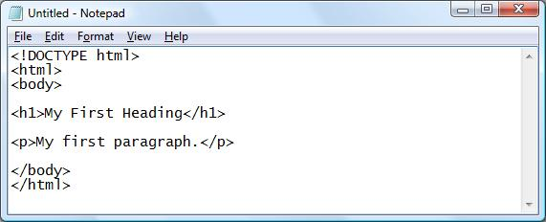
Writing HTML Using Notepad or Text Editors
Step 1: Start Notepad
To start Notepad go to:
Start
All Programs
Accessories
Notepad
Step 2: Edit Your HTML with Notepad
Type your HTML code into your Notepad:

Slide 31
Writing HTML Using Notepad or Text Editors
Step 3: Save Your HTML
Step 4: Run the HTML in Your Browser

Slide 32
HTML Forms
The forms are used to pass data to a server.
HTML forms can contain input components like text fields, checkboxes, radio-buttons, submit buttons and more.

Slide 33

Text Fields
<form>
First name: <input type="text“ name="firstname"> <br>
Last name: <input type="text" name="lastname">
</form>

Slide 34

Password Field
<input type="password"> defines a password field:
<form>
Password: <input type="password" name="pwd">
</form>

Slide 35

Radio Buttons
<input type="radio"> defines a radio button. Radio buttons let a user select ONLY ONE of a limited number of choices:
<form>
<input type="radio" name= "gender" value="male">Male<br>
<input type="radio" name= "gender" value="female">Female
</form>

